Slide 1
Elastic load balancer - elb
- Velocity training institute
- Shantanu Mahajan (sr engg devops)

Slide 2
Elastic load balancer
A load balancer is a device that distributes network or application traffic across a number of servers.
ELB distributes incoming traffic amongst various EC2 instances or available servers.
ELB can distribute the load in between single AZ or multiple AZ
ELB helps increase fault tolerance and makes sure there is high availability of the application 24*7.

Slide 3
How does it work?
Load balancer checks on which server the traffic is less and accordingly forwards the request to the corresponding server.
Incase any of the server is down it will move the request to any of the heathy server which is configured.
Here we have to note that the load balancer will also do health checks on a regular time intervals and forward requests only to the healthy server.
Usually load balancing is done together with auto-scaling, if any server is faulty then it gets replaced by a healthy server.

Slide 4
Types of load balancers
Application load balancer
Network load balancer
Classic load balancer – will be decommissioned soon by AWS
GATEWAY load balancer – new addition to AWS

Slide 5
OSI (open system interconnection) model
The Open Systems Interconnection model is a conceptual model that characterizes and standardizes the communication functions of a telecommunication or computing system without regard to its underlying internal structure and technology

Slide 6
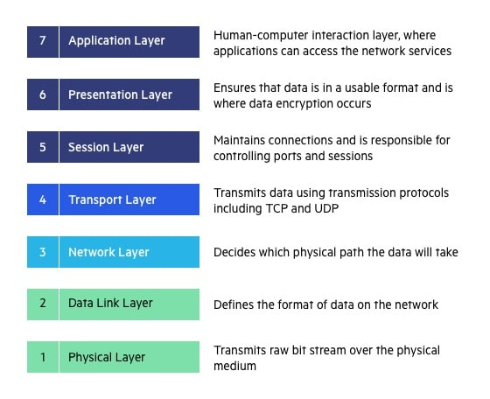
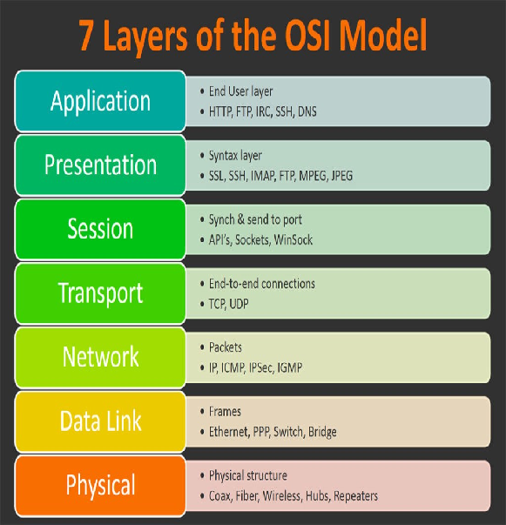

Slide 7
Application load balancer
Application load balancer is used for mobile applications or web applications.
ALB operates at the application layer of the OSI model, i.e. layer 7
ALB is able to inspect application level content and route traffic based on HTTP and HTTPS protocol.
Also ALB can route based on HTTP headers. For eg we want to access application which has a header /foo or /bar its possible

Slide 8
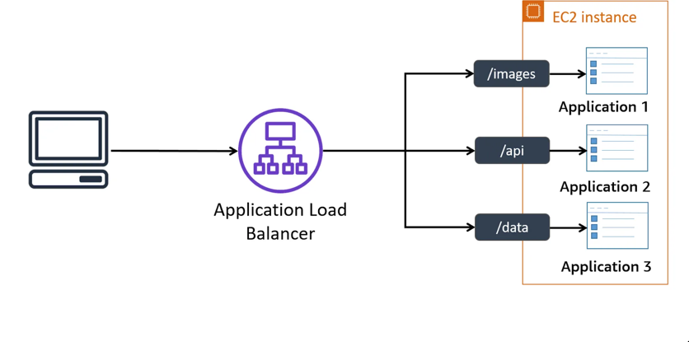

Slide 9
Network load balancer
Network load balancer works on Layer 4 i.e is transport layer of OSI model.
Basically network load balancer provides low latency (response time) and can manage heavy loads at a time.
Network LB works on TCP/UDP/TLS protocols.

Slide 10
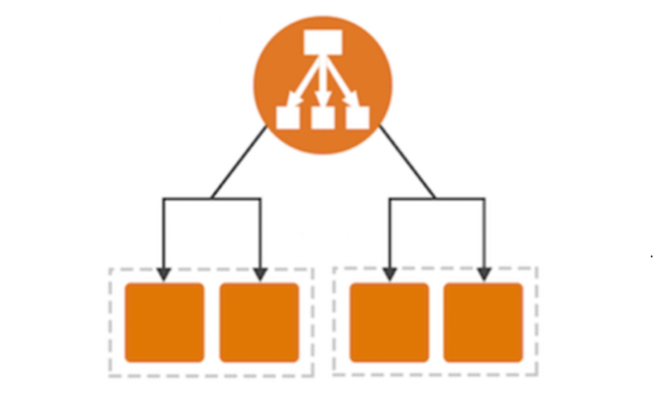

Slide 11
Key difference
NLB just forward requests whereas ALB examines the contents of the HTTP request header to determine where to route the request.
When you need to seamlessly support spiky or high-volume inbound TCP requests we use the network load balancer.
ALBs are typically used for web applications. If you have a microservices architecture, etc

Slide 12
HTTP vs TCP
Hypertext Transfer Protocol (HTTP) and Transmission Control Protocol (TCP) are both computer protocols involved in the transfer of data, but while they individually serve their own purpose, they have a close relationship.
HTTP is a request-response protocol that allows users to communicate data on the World Wide Web (WWW) and transfer hypertext. The protocol remains one of the primary means of using the Internet and provides users a way to interact with web resources such as HTML files by transmitting hypertext messages between clients (such as a web browser like Chrome) and a server. Essentially, it’s used to load web pages using hypertext links.

Slide 13
HTTP vs TCP
TCP, short for Transmission Control Protocol, is a communication standard that enables application programs and computing devices to exchange data and/or messages over networks.

Slide 14
The Main Differences Between HTTP and TCP
HTTP typically uses port 80 – this is the port that the server “listens to” or expects to receive from a Web client. TCP doesn’t require a port to do its job.
HTTP is faster in comparison to TCP as it operates at a higher speed and performs the process immediately. TCP is relatively slower.
TCP tells the destination computer which application should receive data and ensures the proper delivery of said data, whereas HTTP is used to search and find the desired documents on the Internet.
TCP contains information about what data has or has not been received yet, while HTTP contains specific instructions on how to read and process the data once it’s received.
TCP manages the data stream, whereas HTTP describes what the data in the stream contains.
TCP operates as a three-way communication protocol, while HTTP is a single-way protocol.

Slide 15
Components of elastic load balancer
Listener:-
A listener is a process that checks for connection requests. It is configured with a protocol and a port for front-end (client to load balancer) connections, and a protocol and a port for back-end (load balancer to back-end instance) connections.
It listens to the incoming requests and fwds requests accordingly.
Target Group:-
This is nothing but a cluster of EC2 instances. The ELB will only fwd the traffic to EC2 instances which are part of target group.

Slide 16
Components of elastic load balancer
Target:-
This is nothing but our individual EC2 instance, there is where we are going to target our traffic.
Health checks:-
This is done to check whether instance is healthy or not. ELB does some prior health checks before registering targets and forwarding traffic to it.

Slide 17
Some important points
Load balancer is region specific.
The load balancer will have a public IP, but the EC2 instances may or may not have public IP, they can communicate with each others based on private IP.
A load balancer will only fwd. the request to the ec2 instance, it doesn’t mean that it will fwd. all the requests. In case of application load balancer it will only fwd http or https requests as it supports that protocol only.
ELB has nothing to do with the other outbound traffic which is generated from EC2 instance to the internet or any other ec2 machine.
If ELB is deleted then EC2 instances attached wont be deleted

Slide 18
Some important points
https://aws.amazon.com/elasticloadbalancing/pricing/
Its always recommended to have equal number of ec2 instances in each zone. (cross zone load balancing)

